Slide 1
American Association of
State Colleges and Universities
Delivering America’s Promise

Slide 2
We are a Higher Education Association
We are not part of any Government

Slide 3
We Are:
A Membership Organization
Of Public Institutions
With Voluntary Membership
Supported by Member Dues
A Not-for-profit Corporation

Slide 4
AASCU’s Distinction Resides
in the Supporting of its Members
Ensuring Support
Advocating for Policy
Strengthening Roles
Sustaining Networks

Slide 5
AASCU has 5 Fundamental Purposes
Promote Understanding
Support Members
Advocate for Effective Policy
Provide Leadership
Create Professional Development

Slide 6
AASCU Values
Access and Inclusion
Student-Focused
Innovation
Service
Leadership
Accountability

Slide 7
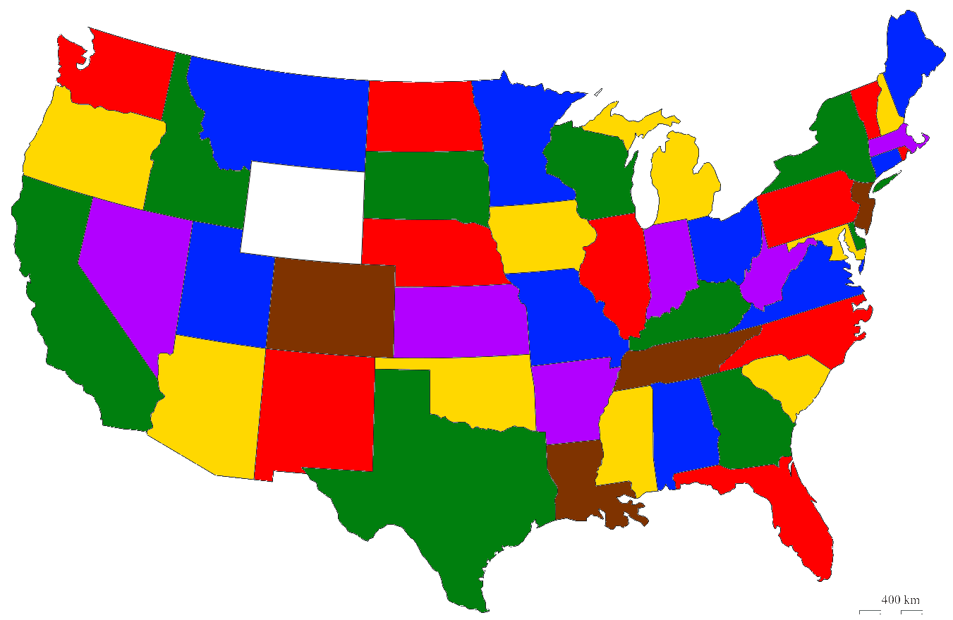
400+ Members
Plus
District of Columbia
Guam
Puerto Rico
Virgin Islands
Around 4 million students
(Fall 2010)

Slide 8
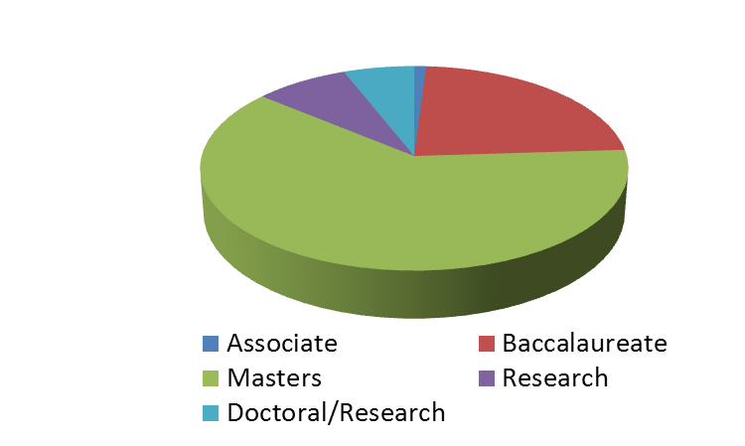
By campus location
Members by Type of Institution

Slide 9
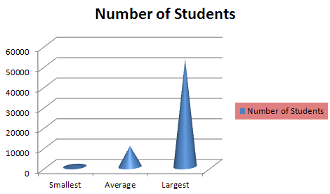
Member Institution Size
823
10,183
53,000

Slide 10
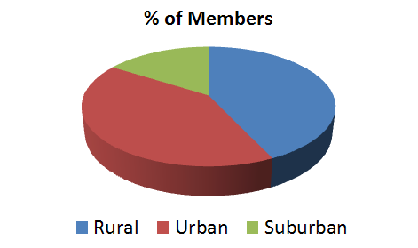
Member’s Campus Location

Slide 11
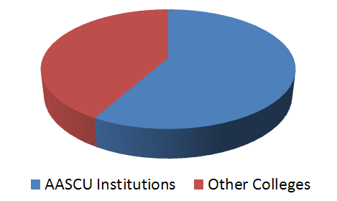
Faculty Are Alumni Of

Slide 12
How AASCU is Organized
Board of Directors
President
Membership
Communications
Government
Relations
Academic
Leadership

Slide 13
What can our Association Do?
We can build programs
We can convene our members
We can look at the broad picture
We can advocate for our members
We can answer difficult questions
We can confer status

Slide 14
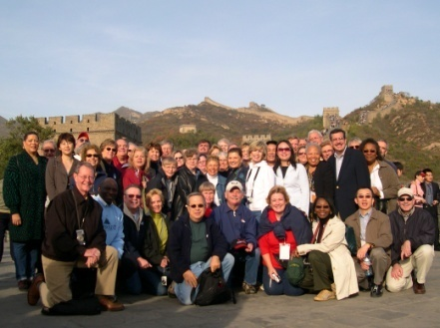
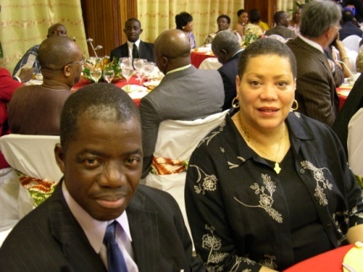
Build Programs: For example, International
China
Liberia

Slide 15
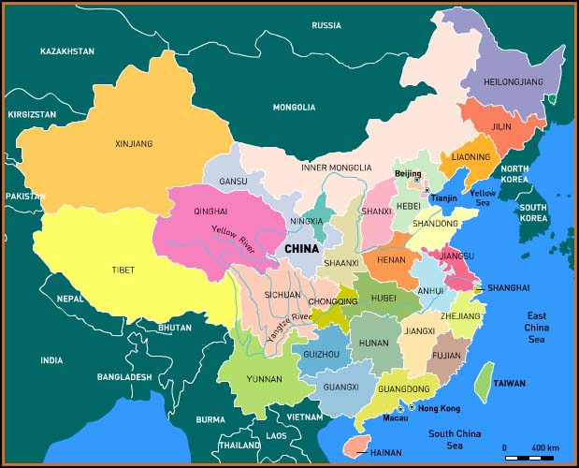
Our Programs With China
China Education Expo and Forum
Undergraduate/Graduate Transfer Program
Visiting Scholars Program
Study in China Scholarship Program and Summer Short-Term Program
Youth Exchange Students Program
PathPro Program
Project Global Access
AACCU/CEAIE China-US Higher Education Leadership and Innovation Center

Slide 16
Presidential Missions
Explore Linkages and
Develop Partnerships

Slide 17
Brazil Scientific Mobility Program
Develop Academic Partnerships

Slide 18
The State of Wisconsin Ranks 5th
in the Nation for the Number
of Brazilian Students Hosted

Slide 19
Brazilian Students’
Summer Internships

Slide 20
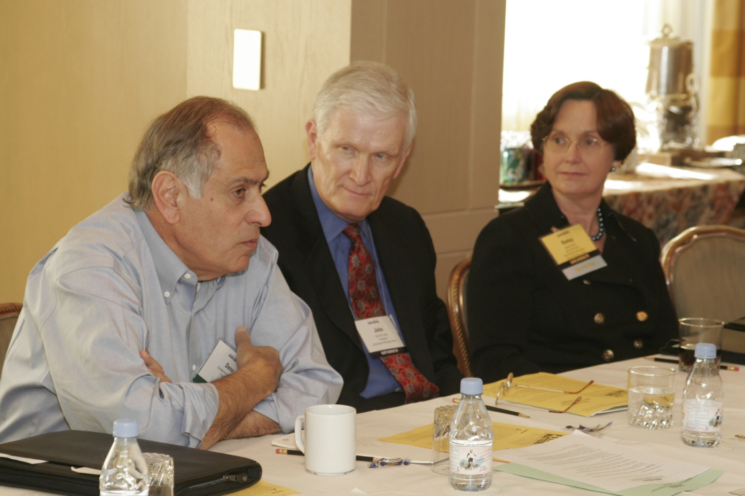
Convene our Members

Slide 21
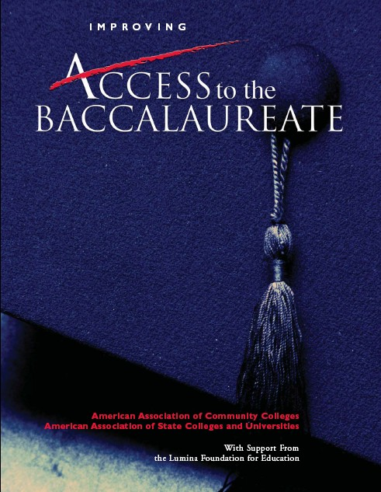
Answer Difficult Questions

Slide 22
Advocate for our Members

Slide 23
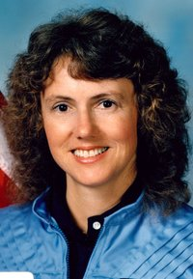
Confer Recognition
Christa
McAuliffe
Teacher Education
Award

Slide 24
Collaborate With Other U.S. Higher Education Associations
APLU
American Association of Community Colleges
National Association of Independent Colleges and Universities
Association of American Universities
American Council on Education

Slide 25
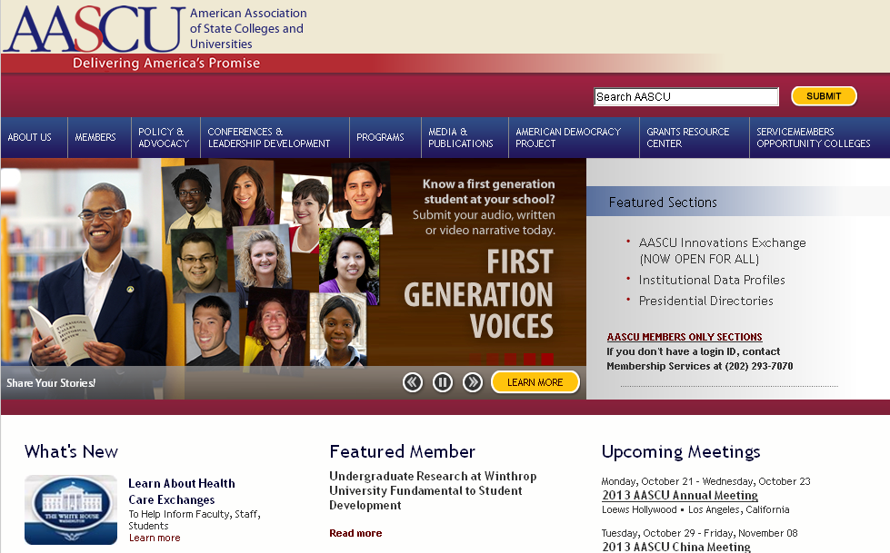
Support Effective Communication

Slide 26
For Additional Information
Arlene Jackson
Director of International Education
(202) 478-7834
www.aascu.org

